Slide 1
Acids & Bases

Slide 2
Our Goals for today
To determine the difference between Acids & Bases
Discuss the importance of studying Acids & Bases
Perform an experiment dealing with Acids & Bases

Slide 3
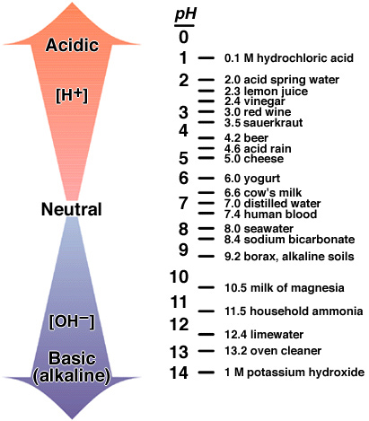
What is the pH scale?
The pH scale measures how acidic or basic a solution is.

Slide 4
The pH scale
The pH scale is the concentration of hydrogen ions in a given substance.

Slide 5
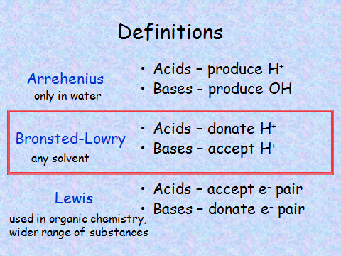

Slide 6
Definitions of Acids and Bases
(Bronsted-Lowry Concept)
An acid is a substance which can donate a proton [H⁺]
A base/alkali is a substance which can accept a proton [H⁺]
Note: The term alkali is reserved for those
substances that yields hydroxyl ions
[OH⁻] on dissociation

Slide 7
Identifying Acids and Bases
Acids have a pH from 0-7
Lower pH value indicates a stronger acid.
Bases have a pH from 7-14
Higher pH value indicates a stronger base.

Slide 8
Characteristics Of Acids
Acids can be characterized by:
A sour taste
It turns blue litmus paper red
Examples: Lemon juice (citric acid);
Orange juice (ascorbic acid);
Vinegar (acetic acid)

Slide 9
Characteristics of Bases
A Base is characterized by:
A bitter taste
It feels soapy/slippery
It turns Red Litmus Blue
Examples: Washing soda (sodium carbonate); Baking soda (sodium bicarbonate); Antacid (milk of magnesia)

Slide 10
Test Your Knowledge
What is the range of an ACID on the pH scale?
Ans: 0-7
What is the range of a BASE and what is another name for a BASE?
Ans: 7-14, Alkali

Slide 11
Test Your Knowledge
What happens when the pH of a substance is 7?
Ans: A pH level of 7 indicates a Neutral Substance, example - Distilled Water!

Slide 12
Today’s Homework
Test the pH of Pepsi, tap water, rain water and drain cleaner
GOOD LUCK!!!

